Slide 1
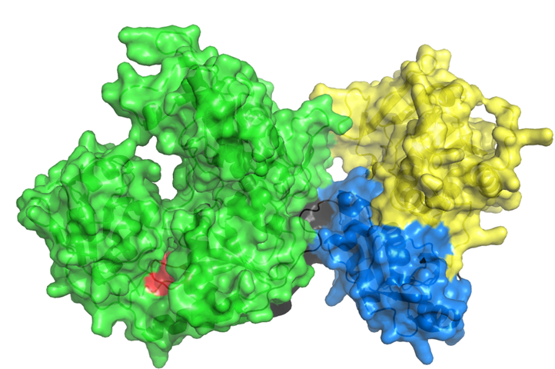


READDI EXP0106: NSP2 Helicase ADP Virtual Screen
Jack Sears
4TH Year Ph.D. Candidate
University of North Carolina – Chapel Hill
Department of Microbiology & Immunology – Heise & Moorman Laboratories

Slide 2
EXP0106 CHIKV 181/25 nLuc Capsid Antiviral Assay NSP2 Helicase ADP Virtual Screen
Notes:
65-70nm diameter icosahedral
Nucleocapsid icosahedral t=4 symmetry with 240 copies of the C protein (120 dimers)
Lipid bilayer envelope contained E1-E2 glycoproteins, 80 trimers of E1-E2, 5’cap and 3’poly-A
Questions:
Species of mosquitoes.
Where did viruses emerge.
Transmission?
E2 and E1
Nucleocapsid icosahedral t=4 symmetry with 240 copies of the C protein (120 dimers)
Lipid bilayer envelope contained E1-E2 glycoproteins, 80 trimers of E1-E2
Nsp1- capping and –strand syn
Nsp2- RNA helicase and protease
Nsp3- ADP ribosyl-binding and hydrolase activity, used for imitation of viral genome replication
Nsp4- RDRP polymerase

Slide 3
EXP0106 VEEV TC83 nLuc nsP3 Antiviral AssaynsP2 Helicase ADP Virtual Screen
Notes:
65-70nm diameter icosahedral
Nucleocapsid icosahedral t=4 symmetry with 240 copies of the C protein (120 dimers)
Lipid bilayer envelope contained E1-E2 glycoproteins, 80 trimers of E1-E2, 5’cap and 3’poly-A
Questions:
Species of mosquitoes.
Where did viruses emerge.
Transmission?
E2 and E1
Nucleocapsid icosahedral t=4 symmetry with 240 copies of the C protein (120 dimers)
Lipid bilayer envelope contained E1-E2 glycoproteins, 80 trimers of E1-E2
Nsp1- capping and –strand syn
Nsp2- RNA helicase and protease
Nsp3- ADP ribosyl-binding and hydrolase activity, used for imitation of viral genome replication
Nsp4- RDRP polymerase

Slide 4
EXP0106 Cell Titer Glo Viability Assays nsP2 Helicase ADP Virtual Screen
Notes:
65-70nm diameter icosahedral
Nucleocapsid icosahedral t=4 symmetry with 240 copies of the C protein (120 dimers)
Lipid bilayer envelope contained E1-E2 glycoproteins, 80 trimers of E1-E2, 5’cap and 3’poly-A
Questions:
Species of mosquitoes.
Where did viruses emerge.
Transmission?
E2 and E1
Nucleocapsid icosahedral t=4 symmetry with 240 copies of the C protein (120 dimers)
Lipid bilayer envelope contained E1-E2 glycoproteins, 80 trimers of E1-E2
Nsp1- capping and –strand syn
Nsp2- RNA helicase and protease
Nsp3- ADP ribosyl-binding and hydrolase activity, used for imitation of viral genome replication
Nsp4- RDRP polymerase

